Slide 1
Practical Exam Practice
CS1020 – Data Structures And Algorithms 1
AY2016-17 Semester 2

Slide 2
Practical Exam
Algorithmic Challenge
Recursion Problem
30%
70%
PSI
My Beautiful Garden
My Beautiful Office
Instruction
Gas Station
Barry Putter

Slide 3
Problem 1
PSI

Slide 4

Count the number of PSIs in a given array A[0…N]of integers.
A positive interval is a subarray of A[0…N]:
A[i..j] where i <= j and
$\sum_{k=i}^{j}{A\left[k\right]>0}$
PSI

Slide 5
Positive Sum Interval
int[] nums = {1, -2, 3, -2}
{1, -2, 3}
{-2, 3}
{3, -2}
{1}
{3}
PSI

Slide 6
O(N²) solution?
Trivial, but need to be smart!
PSI

Slide 7
PAUSE AND THINK
What is the idea?
For every pair (i,j) such that i<=j, sum of A[i…j] is positive. There are N² possible pairings of i and j. You can get the sum of A[i…j] in O(N), hence this will lead into an O(N³) solution.
What do I need to do?
For every pair (i,j) such that i<=j, determine sum of A[i…j] in constant time (or in big-O notation, O(1))
Maintain a PREFIX SUM array!
int[] sums = array of size n
sums[0] = nums[0];
for (i ← 1 to N-1) DO:
sums[i] = sums[i-1] + nums[i]
DONE
PSI

Slide 8
Positive Sum Interval: O(N²) solution
int[] nums = {1, -2, 3, -2}
int[] sums = {1, -1, 2, 0}
For all i <= j → nums[i…j] is a PSI → sums[j] – sums[i-1]* > 0
i | j | sums[j] – sums[i-1] | Result | The subarray
0 | 2 | If i is 0, get sum[j] instead | 2 | {1, -2, 3}
1 | 1 | sums[1] – sums[0] gets nums[1] | -2 | {-2}
1 | 3 | sums[3] – sums[0] | -1 | { -2, 3, -2}
2 | 3 | sums[3] – sums[1] | 1 | {3, -2}
2 | 2 | sums[2] – sums[1] | 3 | {3}
*Be careful when i = 0
PSI

Slide 9
Problem REPHRASED
For all i <= j → nums[i … j] is a PSI → sums[j] – sums[i-1] > 0
For all i+1 <= j → nums[i … j] is a PSI → sums[j] – sums[i] > 0
For all i < j → nums[i … j] is a PSI → sums[j] – sums[i] > 0
For all pairs (i,j) such that i < j → sums[i] > sums[j]
PSI

Slide 10
Merge Sort Idea
PSI(Array) =
PSI(Left Subarray) + PSI(Right Subarray) + PSI(Subarray where i is in left subarray and j is in right subarray)
PSI

Slide 11
i < j
For all i in left subarray and j in right subarray
sums[…]
Take sums[leftCounter] and sums[rightCounter]
If sums[leftCounter] < sums[rightCounter]?
All sums[p] where p >= leftCounter (and p <= mid) are less than sum[rightCounter]
Beware of overflow! (use long instead of int)
PSI

Slide 12
Problem 2
Instruction

Slide 13
Problem Description
Given N number of instructions and a target value (K)
For each instruction, you can choose to apply or not to apply it
Starting from index 0, find the value that is of the closest possible value to K
Difference between the value and K must be as minimal as possible
If there are 2 answers with the same difference, choose the smaller value as the answer
i.e If K == 10, answer 1 = 6, answer 2 = 14, answer 1 is the correct answer.
Instruction

Slide 14
Steps to forming a recursive solution:
Base Case
No more instructions to ‘choose’ from
“To choose or not to choose, that is the question”
Recursive
Step
Instruction

Slide 15
Recursion Tree
0
+4
+4
0
4
+3
+3
+3
+3
0
3
4
7
*3
*3
*3
*3
*3
*3
*3
*3
0
0
3
9
4
12
7
21
Instruction

Slide 16
So… Now what?
After calculating the possible answers, how do we determine which to choose?
Return the answer that is ‘closest’ to K
But how do we determine that?
Simplest way: Use Math.abs(target - number)
Why take absolute value
10
TARGET 14
20
Instruction

Slide 17
Recursion Tree (K = 10)
0
9
12
0
4
0
9
12
7
0
3
4
7
0
0
3
9
4
12
7
21
0
0
3
9
4
12
7
21
Instruction

Slide 18
Recursion Tree
0
9
12
+4
+4
0
4
0
9
12
7
+3
+3
+3
+3
0
3
4
7
0
0
3
9
4
12
7
21
*3
*3
*3
*3
*3
*3
*3
*3
0
0
3
9
4
12
7
21
Instruction

Slide 19
Problem 3
Gas Station

Slide 20
You can refuel or not refuel at each city between your home and Singapore.
Each city has a different refueling cost. If you refill, you must fill until full.
When should you refuel?
Are you even capable of reaching the destination?
Gas Station

Slide 21
“To refuel or not to refuel, that is the question”
Gas Station

Slide 22
int refuel = /* go to next city, refueling at the current city */
int nofuel = /* go to next city, do not refuel at current city */
return Math.min(refuel, nofuel);
Recursive Calls.
Same concept as Instruction:
Apply instruction or not VS
Refuel or not
Gas Station

Slide 23
Problem 4
My Beautiful Garden

Slide 24
Problem Description
You are given R x C grids.
There are N mines located within the grids.
You are given all the mines coordinates.
Asked:
Determine the number of “sub-squares” in the grid that do not contain any mines.
Note: A “sub-square” can be of any size, as long as it is inside the garden and is square ☺.

Slide 25
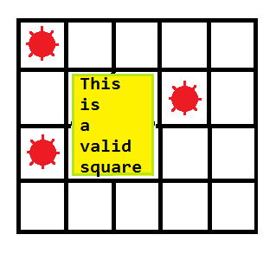
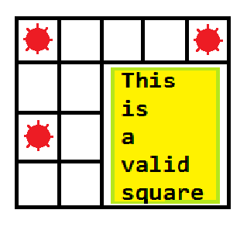
Valid Square Examples
A valid 2 by 2 sub-square
A valid 3 by 3 sub-square

Slide 26
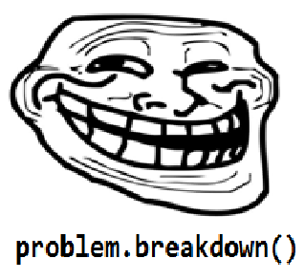
Breaking Down The Problem
problem.breakdown();
Compile error? Good.
How do we count the number of demined sub-squares?
Try all possible squares and check if they don’t explode. (they what!?)

Slide 27
Solution 1: The Naïve-est Approach
For i <- each row
For j <- each column
For k <- each possible square size starting from (i, j)
noMinesHere <- true
// Check if the square starting from (i, j) with size k is demined.
For m <- i to i + k – 1
For n <- j to j + k – 1
if grid[i][j] is mined
noMinesHere <- false
// We lost.
if noMinesHere, answer++
You mean “most naïve”?
Maybe..

Slide 28
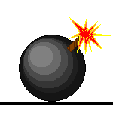
Animations, anyone?
ANSWER = 1
ANSWER = 2
ANSWER = 3
ANSWER = 4
ANSWER = 5
ANSWER = 0

Slide 29

Why the animation stops?
It should be clear to you by now.
AND
I’m too lazy to animate all of them.

Slide 30
Time Complexity?
5 nested for loops, each can go up to R rows or C columns (suppose that both of them are capped at N).
Complexity: O(R * C * min(R, C)³) or just O(N⁵).
When N = 500, a 100 Megaflops (10⁸ operations/second) computer will take 87 hours to finish processing.
Good luck with that..

Slide 31
Solution 2: Not So Naïve This Time
For i <- each row
For j <- each column
For k <- each possible square size starting from (i, j)
noMinesHere <- true
// Check if the square starting from (i, j) with size k is demined.
For m <- i to i + k – 1
For n <- j to j + k – 1
if grid[i][j] is mined
noMinesHere <- false
// We lost.
if noMinesHere, answer++
We can improve this

Slide 32
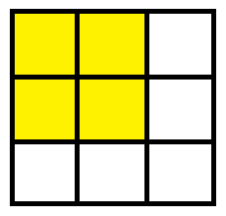
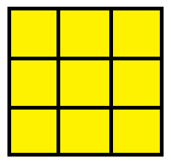
B..B..But How?
See the difference?

Slide 33
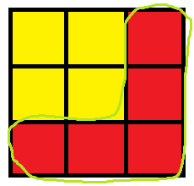
Kinda like this..

Slide 34
So…
When we increase the size of the square, there is no need to recheck the entire new square.
Just check the new grids that are added to the previous square.

Slide 35
Observation Doesn’t Give You Marks, Code Does
For i <- each row
For j <- each column
stillNoMines <- true
For k <- each possible square size starting from (i, j)
For m <- i to i + k – 1
if grid[m][j] is mined
stillNoMines <- false
For n <- j to j + k – 1
if grid[i][n] is mined
stillNoMines <- false
if stillNoMines, answer++
else break // no need to check bigger sizes.
Parallel loops are O(N)

Slide 36

Time Complexity?
3 nested for loops with 2 parallel loops inside them.
Complexity: O(N³ * (N + N)) = O(N⁴)
When N = 500, a 100 Megaflops (10⁸ operations/second) computer will take 10 minutes to finish processing.
Down from days to minutes.

Slide 37

Solution 3: This is Awesome
Again, we improve on the checking part (checking whether a specific sub-square contains mines).
We did it in O(N²), then O(N), now can we do it in O(1)?

Slide 38
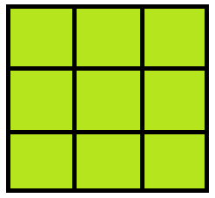
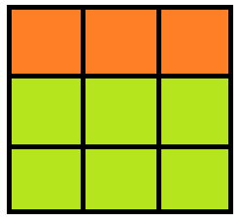
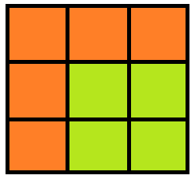
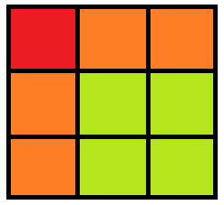
Why not?
Checking the square from (1, 1) to (2, 2)

Slide 39
I Just Lost You There…
OK. This might help you:
The number of mines at square starting from (i, j) and ending at (m, n) is (wait for it..):
pref[m][n] – pref[i – 1][n] – pref[m][j – 1]
+ pref[i – 1][j – 1] (Why? ☺)
Pref [ i ] [ j ] is the number of mines in the submatrix from (0, 0) to (i, j).
Still confused? Click here.

Slide 40
Code Please!!!
For i <- each row
For j <- each column
For k <- each possible square size starting from (i, j)
/*
* Get number of mines in square starting * from (i, j) ending at (i+k-1, j+k-1).
*/
numMines <- pref[i + k – 1][j + k – 1]
- pref[i – 1][j + k - 1]
- pref[i + k - 1][j – 1]
+ pref[i – 1][j – 1]
if numMines is 0
answer++

Slide 41
Time Complexity?
3 nested loops with O(1) check inside them.
Complexity: O(N³)
When N = 500, a 100 Megaflops (10⁸ operations/second) computer will take 1.25 seconds to finish processing.
Down from minutes to seconds.

Slide 42

Can We Do Better?
But the 110% requirement in the PE is O(N³), why don’t we stop here?
OK. To be fair, you can stop here. Proceed only if you want to ;)

Slide 43
Our Milestone
So, we have managed to reduce the time complexity of the check operation from O(N²) to O(1).
What else can we reduce?
Can we not check through all the possible sizes? This operation currently takes O(N) complexity.

Slide 44
Observation
When we try all square sizes (1..k) which starts from (i, j), we will get a sequence like this:
Square size 1 2 3 4 …. k-3 k-2 k-1 k
Mines exist 0 0 0 0 …. 0 1 1 1
Where 0 indicates there are no mines, and 1 indicates mines exist.
The sequence here will always start with A number of 0’s followed by B number of 1’s.
A and B can be any arbitrary numbers.

Slide 45
You Learn Something New Everyday
Searching in an ordered list is where binary search prevails.
The appearance of mines as a function of square size, denoted as M(size), results in an ordered list (All 0’s come before 1’s).
We do binary search to find where the first ‘1’ occur. (also called lower bound)
Answer += lowerBound(M[size]).

Slide 46
Implementation
For i <- each row
For j <- each column
left <- 0;
right <- max possible square size starting from (i, j)
while left < right // start binary search
m <- (left + right) / 2
numMines <- pref[i + m – 1][j + m – 1]
- pref[i – 1][j + m - 1]
- pref[i + m - 1][j – 1]
/*use a helper*/ + pref[i – 1][j – 1]
if numMines is 0
left <- m + 1
else
right <- m
ans <- ans + left // left = right here

Slide 47
Time Complexity?
2 nested loops with a binary search inside.
Complexity of binary search is O(log N).
Overall time complexity: O(N² logN).
Big improvement?
YES!
When N = 500, a 100 Megaflops (10⁸ operations/second) computer will take 0.0225 seconds to finish processing.
Compare this to 1.25 seconds with O(N³) algo.

Slide 49
Why not O(N²)
An algorithm (or more appropriately, a paradigm) can solve this problem in O(N²) time complexity.
This is called Dynamic Programming.
It is based on the fact that there are overlapping sub-problems in finding the solution which are evaluated multiple times.
Let’s see how our problem is constantly overlapping.

Slide 50
Overlapping Sub-problems
Here, we stop checking squares starting from (0, 0) because larger squares will always have bomb at (1, 1).
Or this…
Or this…
But then, we don’t need to check this…

Slide 51
OK… Then How?
We will leave it to you to explore this O(N²) algorithm since it is out of this module’s scope.
You might want to read this. (Don’t worry, not lmgtfy)
Good luck! ;)

Slide 52
End Of File
Any Questions?

